Slide 1
Integrated mathematical and computer models of the information warfare
NUGZAR KERESELIDZE
Sukhumi State University, Georgia
CMC II, Van, Turkey, 22-24 august 2017

Slide 2
Integrated mathematical and computer models of the information warfare,
NUGZAR KERESELIDZE - Sukhumi state university, Georgia
CMC II, Van, Turkey, 22-24 august 2017
Under the term "Information warfare" we will mean the activity of the sides, involved in the confrontations, using the logos, the word - with weapons.
In reality, value of the term "Information Warfare" is wider than how we use it.
The side in the information warfare uses the logo for misinformation, discrediting, etc., the enemy.

Slide 3
Integrated mathematical and computer models of the information warfare,
NUGZAR KERESELIDZE - Sukhumi state university, Georgia
CMC II, Van, Turkey, 22-24 august 2017
At this stage, two approaches in the mathematical and computer modeling of information warfare can be identified.
In the first case, by using the model we can investigate the number of people who accepted dissemination of information. I.e. become adepts of this information.
In the second case, with the help of the model, the amount of information disseminated by the parties to the information warfare is investigated. I.e. flows of information are modeled.

Slide 4
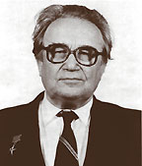

Integrated mathematical and computer models of the information warfare,
NUGZAR KERESELIDZE - Sukhumi state university, Georgia
CMC II, Van, Turkey, 22-24 august 2017
The first direction in the modeling of information warfare (adepts) was founded by Russian scientists: Academician A.A. Samarskiy and Professor A.P. Mikhailov in 1997 [1] .
Notes:
Academician A.A. Samarskiy (19.02.1919-11.01.2008), Professor A.P. Mikhailov 11.02.1947. Samarskiy A.A., Mikhailov A.P. Mathematical modeling: Ideas. Methods. Examples. 1st – 1997, 2 nd ed. Correction. - M. FIZMATLIT. 2005. 320 pp.

Slide 5
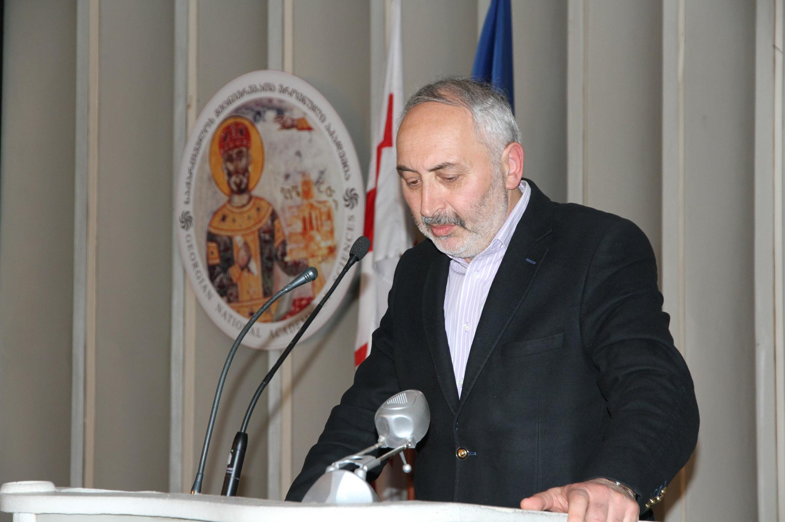
Integrated mathematical and computer models of the information warfare,
NUGZAR KERESELIDZE - Sukhumi state university, Georgia
CMC II, Van, Turkey, 22-24 august 2017
The second trend in the modeling of information warfare (flows) was founded by the Georgian scientist - Professor T.I. Chilachava. The first publications in this direction appeared in 2009, co-authors: T.I. Chilachava and N.G. Kereselidze [2,3].

Slide 6
Integrated mathematical and computer models of the information warfare,
NUGZAR KERESELIDZE - Sukhumi state university, Georgia
CMC II, Van, Turkey, 22-24 august 2017
Let's briefly review the main directions in the mathematical and computer modeling of information warfare.
First, let's consider the mathematical model of the advertising company, proposed by Academician A.A. Samarskiy and Professor A.P. Mikhailov in 1997.
The model of the advertising company later became known as the information security model - 2002 [4], the information dissemination model - 2004 [5], the information confrontation model - 2009 [6], the information warfare model - 2011 [7], model of information attack and confrontation - 2015 [8].
Such an abundance of the name of one model can be explained by the universality of mathematical modeling.
We will call this model the Samarskiy-Mikhailov model.

Slide 7
Integrated mathematical and computer models of the information warfare,
NUGZAR KERESELIDZE - Sukhumi state university, Georgia
CMC II, Van, Turkey, 22-24 august 2017
Samarskiy-Mikhailov mathematical model
Let spread some information in a society with a number of people – X₀ .
x(t) is the number of people who perceive this information (adepts) at time t.
α₁(t) - the intensity of the information (advertising) campaign.
α₂(t) – the intensity of the information (advertising) campaign of the adepts, who also begin to distribute the obtained information.

Slide 8
Integrated mathematical and computer models of the information warfare,
NUGZAR KERESELIDZE - Sukhumi state university, Georgia
CMC II, Van, Turkey, 22-24 august 2017
On the basis of MM of Samarskiy-Mikhailov Professor Mikhailov A.P. with co-authors has created the model with forgetting, at the same time charac-terizes intensity of forgetting of infor-mation by the individual [7].
(3)
(4)

Slide 9
Integrated mathematical and computer models of the information warfare,
NUGZAR KERESELIDZE - Sukhumi state university, Georgia
CMC II, Van, Turkey, 22-24 august 2017
Based on MM Samarskiy-Mikhailov Professor Mikhailov A.P. with co-authors has created a model of information confrontation, when two different information are disseminated in the society [7].

Slide 10
Integrated mathematical and computer models of the information warfare,
NUGZAR KERESELIDZE - Sukhumi state university, Georgia
CMC II, Van, Turkey, 22-24 august 2017
We note that MM Samarskiy-Mikhailov reduces to the equation of P. Verhulst, but differs from the latter. In particular, the solution of the P. Verhulst equation - the logistic cover at zero point is positive. And the decision of MM Samarskiy-Mikhailov at the starting point is equal to zero, as follows from the meaning of the problem.
The decision of MM Samarskiy-Mikhailov at a constant intensity of the advertising campaign - α and adepts – β, has the form

Slide 11
Integrated mathematical and computer models of the information warfare,
NUGZAR KERESELIDZE - Sukhumi state university, Georgia
CMC II, Van, Turkey, 22-24 august 2017
In the mathematical models of the Information Warfare of the Samarskiy-Mikhailov type, the possibilities of increasing the number of adepts are researched, also the optimization of this process, etc.
Additional information can be found in [9].
We note that in the MM of the Samarskiy-Mikhailov type, the number of information streams is clearly not present.

Slide 12
Integrated mathematical and computer models of the information warfare,
NUGZAR KERESELIDZE - Sukhumi state university, Georgia
CMC II, Van, Turkey, 22-24 august 2017
In other approach of mathematical modeling of information warfare, namely, information flows (Chilachava T. [2, 3, 10], Kereselidze N. [2,3], Chakhvadze A. [10], Bimal kumar Mishra [11], Apeksha Prajapati [11] and others) actions of three sides are researched.
In these models, as suggested by Professor T. Chilachava, the two sides spread information flows of misinformation and discredit against each other, while the third party is peacemaking, calls on them to stop the information warfare.

Slide 13
Integrated mathematical and computer models of the information warfare,
NUGZAR KERESELIDZE - Sukhumi state university, Georgia
CMC II, Van, Turkey, 22-24 august 2017
If the sides in time point extend an information flows in volume respectively, then the first MM of
information flows has an appearance (5),(6)
(5)
(6)
Notes:
General linear continuous mathematical model of information warfare flows, (6) initial conditions. (5), (6) is the Cauchy problem. 2009

Slide 14
Integrated mathematical and computer models of the information warfare,
NUGZAR KERESELIDZE - Sukhumi state university, Georgia
CMC II, Van, Turkey, 22-24 august 2017
Ignoring model of the enemy of information flow MM has been analytically researched. (7), (6). in particular, the information warfare stopping conditions have been established - when the two antagonistic sides stop their dissemination of information
(7)

Slide 15
Integrated mathematical and computer models of the information warfare,
NUGZAR KERESELIDZE - Sukhumi state university, Georgia
CMC II, Van, Turkey, 22-24 august 2017
MM of information flows of information warfare with consideration of Informational technologies - with restrictions looks like (8), (6), where the maximum sources of information, which the corresponding side can spread, with the consideration of their technological capabilities
(8)

Slide 16
Integrated mathematical and computer models of the information warfare,
NUGZAR KERESELIDZE - Sukhumi state university, Georgia
CMC II, Van, Turkey, 22-24 august 2017
As can be seen, in the MM of information warfare of the information flow type, there are no adepts of information being disseminated.
On the other hand, in the ММ of information warfare of the Samarskiy-Mikhailov type there are no information flows, although there are adepts of these information flows.
The question is raised, whether it is possible to create a generalized mathematical model of information war, in which both adepts and information flows would be present? I.e., whether it is possible to integrate models of the Samarskiy-Mikhailov type and the Chilachava type into a general model?
We will try to answer these questions positively, and build integrated mathematical and computer models of information warfare.

Slide 17
Integrated mathematical and computer models of the information warfare,
NUGZAR KERESELIDZE - Sukhumi state university, Georgia
CMC II, Van, Turkey, 22-24 august 2017
We introduce the notation:
the first, second and third sides distribute at the time , respectively, amount of information;
The maximum number of the population of the first side – person, the second side - ;
adepts of the first side information from population disseminate amount of information;
adepts of the second side information from population disseminate amount of information;

Slide 18
Integrated mathematical and computer models of the information warfare,
NUGZAR KERESELIDZE - Sukhumi state university, Georgia
CMC II, Van, Turkey, 22-24 august 2017
adepts of the information of the first side from population disseminate amount of information;
adepts of the information of the first side from population disseminate amount of information;
We will designate so-called "useful" information for the first side as
We will designate so-called "useful" information for the second side as

Slide 19
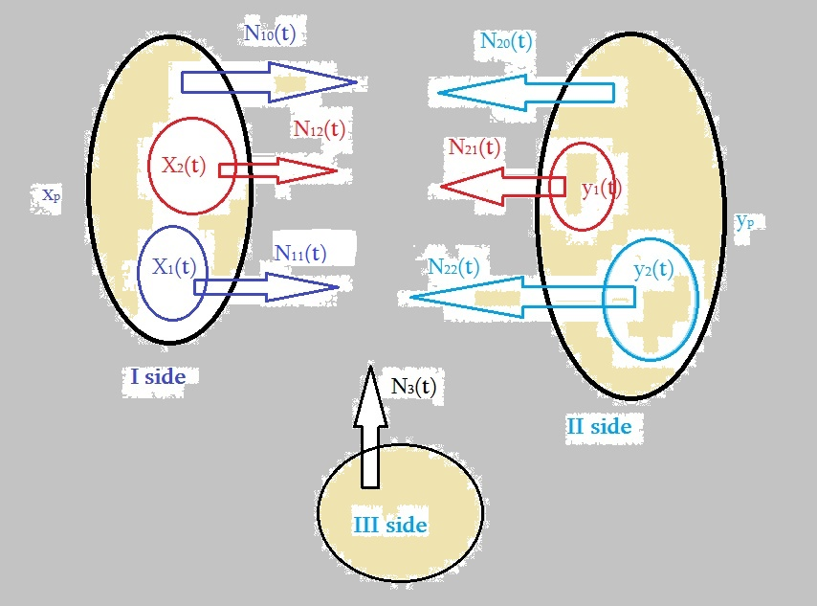
Integrated mathematical and computer models of the information warfare,
NUGZAR KERESELIDZE - Sukhumi state university, Georgia
CMC II, Van, Turkey, 22-24 august 2017
Schematic representation of the subjects and processes, described by the Integrated Mathematical Model of Information Warfare
Notes:
Schematic representation of the subjects and processes, described by the Integrated Mathematical Model of Information Warfare.

Slide 20
The integrated Mathematical model of Information war with the linear dissemination of information of the sides and the partial restriction
Integrated mathematical and computer models of the information warfare,
NUGZAR KERESELIDZE - Sukhumi state university, Georgia
CMC II, Van, Turkey, 22-24 august 2017

Slide 21
Integrated mathematical and computer models of the information warfare,
NUGZAR KERESELIDZE - Sukhumi state university, Georgia
CMC II, Van, Turkey, 22-24 august 2017
In the system (11) all notations are known, except I4, I5, I6, I7. They are the maximum value of the information technology usage in disseminating the information by the corresponding adherents
Next, we will consider simpler integrated mathematical and computer models for ignoring the enemy. They are, actually, a model problem.

Slide 22
Integrated mathematical and computer models of the information warfare,
NUGZAR KERESELIDZE - Sukhumi state university, Georgia
CMC II, Van, Turkey, 22-24 august 2017
In the model task of ignoring the enemy, we will consider two types of adepts , which we denote respectively

Slide 23
Integrated mathematical and computer models of the information warfare,
NUGZAR KERESELIDZE - Sukhumi state university, Georgia
CMC II, Van, Turkey, 22-24 august 2017
In (12) last two equations of model Samarskiy - Mikhailov decide analytically
Let’s insert from (13) into the first two equations of (12), we receive
Initial conditions

Slide 24
Integrated mathematical and computer models of the information warfare,
NUGZAR KERESELIDZE - Sukhumi state university, Georgia
CMC II, Van, Turkey, 22-24 august 2017
In the model problem (14), is the aggressiveness factor of the antagonistic sides; - the coefficient of their peacekeeping readiness; is an indicator of peacekeeping activity of a third side.
In the task (7) - models like flows, its decision radically de-pends on a ratio of . And, on , As we will see later, we have a similar case for (14).
By the end of the information warfare we will consider the situation when, by the efforts of a third party, the system from the state (15) (initial conditions) will be transferred to a state (16) (final conditions), and are not fixed and represent different ones.

Slide 25
Integrated mathematical and computer models of the information warfare,
NUGZAR KERESELIDZE - Sukhumi state university, Georgia
CMC II, Van, Turkey, 22-24 august 2017
Thus we received the boundary task for system ordinary differential equations – (14), (15), (16).
Boundary conditions (15), (16) when the right part is not fixed and addresses in zero in different time points, will be called boundary conditions type Chilker.
We will call the task (14), (15), (16) with boundary conditions type Chilker the Chilker task.
If there is a decision of the Chilker task, it means that information warfare will be ended.

Slide 26
Integrated mathematical and computer models of the information warfare,
NUGZAR KERESELIDZE - Sukhumi state university, Georgia
CMC II, Van, Turkey, 22-24 august 2017
The Chilker problem (14), (15), (16) will be solved numerically in the Mat Lab environment by the ode15s solver. With a computer experiment we will select different values of the D - level of aggressiveness.
%integrirebuli_ignorir_uSvebs povnas
[T,Y]=ode15s(@GAE1,[0,0.15],[0.002 .001 .3 0 0]);
plot(T,Y,'linewidth',2); title('inf warfare'); xlabel('Time')
ylabel('amount of information'); legend('n1','n2','n3','x','y'); grid on
%Integrirebuli MMIW_ode-s marjvena mxareebi
function dxdt=GAE1(t,x)
dxdt=zeros(5,1); a1=.08; a2=.05; b1=1.5; a21=.06; a22=.03; b2=1.7;
p4=155; p5=150; g1=.05; g2=.03; g3=.07; a3=.3; m1=.2; a4=.2; m2=.3;
dxdt(1)=a1*x(1)+a2*x(4)-b1*x(3); dxdt(2)=a21*x(2)+a22*x(5)-b2*x(3);
dxdt(3)=g1*x(1)+g2*x(2)+g3*x(3); dxdt(4)=(a3*x(1)+m1*x(4))*(p4-x(4));
dxdt(5)=(a4*x(2)+m2*x(5))*(p5-x(5)); end

Slide 27
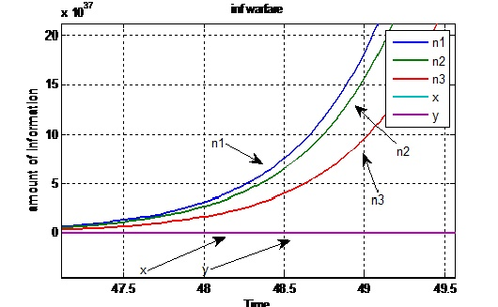
Integrated mathematical and computer models of the information warfare,
NUGZAR KERESELIDZE - Sukhumi state university, Georgia
CMC II, Van, Turkey, 22-24 august 2017
The information warfare does not end (the Chilker problem does not have a solution), when , when
The third party cannot bring any of the sides to zero.
,

Slide 28
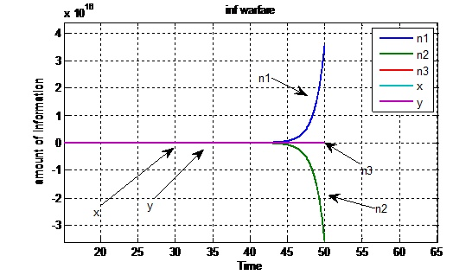
Integrated mathematical and computer models of the information warfare,
NUGZAR KERESELIDZE - Sukhumi state university, Georgia
CMC II, Van, Turkey, 22-24 august 2017
The information war does not end (the Chilker problem has no solution), when the aggressiveness is still high , when
. The third side brings only one side to zero.

Slide 29
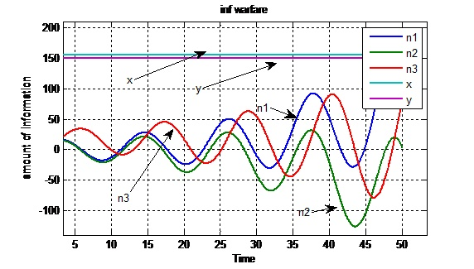
Integrated mathematical and computer models of the information warfare,
NUGZAR KERESELIDZE - Sukhumi state university, Georgia
CMC II, Van, Turkey, 22-24 august 2017
When the index of aggressiveness is small- , for , , then the third party is able to complete the information war-to bring both antagonistic sides to zero.

Slide 30
Integrated mathematical and computer models of the information warfare,
NUGZAR KERESELIDZE - Sukhumi state university, Georgia
CMC II, Van, Turkey, 22-24 august 2017
We will generalize the task Chilker (14)-(16), having replaced system (14) with the following system

Slide 31
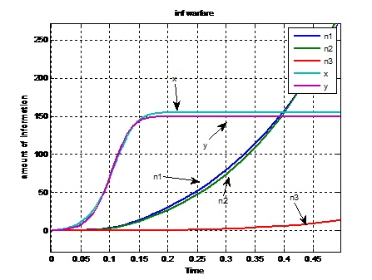
Integrated mathematical and computer models of the information warfare,
NUGZAR KERESELIDZE - Sukhumi state university, Georgia
CMC II, Van, Turkey, 22-24 august 2017
For the Chilker problem (7), (15), (16) with high aggressiveness of the sides, and low peacekeeping readiness and activity –
, there is no solution.

Slide 32
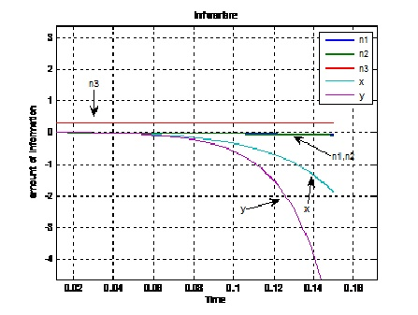
Integrated mathematical and computer models of the information warfare,
NUGZAR KERESELIDZE - Sukhumi state university, Georgia
CMC II, Van, Turkey, 22-24 august 2017
For the Chilker problem (7), (15), (16) with low aggressiveness of the sides, and high peacekeeping readiness and activity –
there is a solution.

Slide 33
Integrated mathematical and computer models of the information warfare,
NUGZAR KERESELIDZE - Sukhumi state university, Georgia
CMC II, Van, Turkey, 22-24 august 2017
Conclusion
The report proposes an attempt to combine existing mathematical models of information warfare: Samarskiy-Mikhailov-type models for adepts and models for information flows proposed by Professor T. Chilachava.
As a result of integration, the mathematical and computer models of information warfare are built: the general continuous linear model, the general and particular model of ignoring the enemy. A computer experiment was carried out for the last two models and conditions for the solvability of the corresponding problems of the Chilker type were established.

Slide 34
Integrated mathematical and computer models of the information warfare,
NUGZAR KERESELIDZE - Sukhumi state university, Georgia
CMC II, Van, Turkey, 22-24 august 2017
Thanks
I would like to express my gratitude to Professor of the Sukhumi State University, Doctor of Physical and Mathematical Sciences Temur Chilachava (Georgia) and Doctor of Physical and Mathematical Sciences Petrov Alexander Pkhoun Zhuo (Russia), the exchange of views with whom affected a research of the offered subject.
Special thanks to the organizers of the CMC II, who gave me the opportunity to speak
Thank you for attention.

Slide 35
References
Samarskiy A.A., Mikhailov A.P. Mathematical modeling: Ideas. Methods. Examples. 1st – 1997, 2 nd ed. Correction. - M. FIZMATLIT. 2005. 320 pp.
2. Chilachava T., Kereselidze N. About one mathematical model of the information warfare. Fifth congress of mathematicians of Georgia. Abstracts of contributed talks. Batumi/Kutaisi, 9-12 October. 2009. p. 85.
3. Chilachava T., Kereselidze N. Non-preventive continuous linear mathematical model of information warfare. Sokhumi State University Proceedings, Mathematics and Computer Sciences vol. 7. 2009, № 7. p. 91 – 112.
4. Mikhailov A.P., Klyusov N.V., On the properties of the simplest mathematical model of the information threat distribution // Mathematical modeling of social processes, issue 4. - Moscow: MAKS Press, 2002, p.115-123.

Slide 36
5. Mikhailov A.P., Izmodenova K.V., On optimal control in the mathematical model of information dissemination. Proceedings of the seminar "Mathematical modeling of social processes", compilation, issue. 6. - Moscow: MAX Press, 2004
6. Marevtseva N.A., The simplest mathematical models of information confrontation. / Series "Mathematical Modeling and Modern Information Technologies", vol. 8. // Collection of works of All-Russian scientific youth schools. Rostov-on-Don, the publishing house of the Southern Federal University. 2009. P. 354-363.
7. Mikhailov A.P., Petrov A.P., Proncheva O.G., Marevtseva N.A. Mathematical Modeling of Information Warfare in a Society // Mediterranean Journal of Social Sciences. Vol. 6. No. 5 S2. pp. 27–35. doi: 10.5901/mjss.2015.v6n5s2p27

Slide 37
8. Mikhailov A.P, Petrov A.P., Proncheva O.G., Marevtseva NA Mathematical modeling of information confrontation in society. International Economic Symposium 2015. Materials of the International scientific conferences devoted to the 75th anniversary of the Faculty of Economics of the St. Petersburg State University: a collection of articles. Ans. Ed. S.A. Belozerov, OOO "Scythia-print", St. Petersburg, 2015. S. 293-303. URL: http://econ-conf.spbu.ru/files/Symposium_Sbornik_Statey.pdf
9. Mikhailov A.P., Petrov A.P., Marevtseva N.A., Tretyakova I.V., Development of the model of information distribution in the society // Mathematical modeling, 2014. T. 26. No. 3. P. 65- 74.
10. Chilachava T., Chakhvadze A. Continuous nonlinear mathematical and computer model of information warfare with participation of interstate authoritative institutes. Georgian Electronic Scientific Journal: Computer Science and Telecommunications 2014| No. 4(44), p. 53 – 74.
11. Bimal kumar Mishra, Apeksha Prajapati. Modelling and Simulation: Cyber War. International Conference on Computational Intelligence: Modeling Techniques and Applications (CIMTA) 2013. Procedia Technology 10 ( 2013 ) 987 – 997. Elsevier.

